Slide 1
Section-2
Mineral Identification pg.68

Slide 2
What you’ll learn
Describe physical properties used to identify minerals.
Identify minerals using physical properties such as hardness and streak.

Slide 3
Physical Properties
Mineral appearance
Hardness
Luster
Specific gravity
Streak
Cleavage and fracture

Slide 4
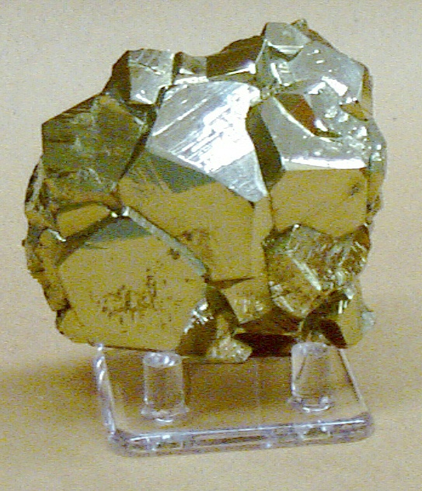
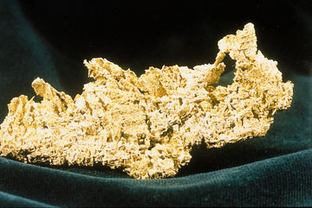
Mineral appearance
How it looks like
What color is it?
Which one of the following is gold? Identify by appearance.

Slide 5
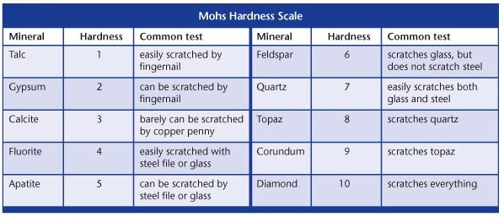
Hardness
A measure of how easily a mineral can be scratched

Slide 6


Properties of Minerals
Mohs Hardness Scale
Mineral
Talc
Gypsum
Calcite
Fluorite
Apatite
Feldspar
Quartz
Topaz
Corundum
Diamond
Rating
Testing Method
1 Softest known mineral. It flakes easily when scratched by a fingernail.
2 A fingernail can easily scratch it.
3 A fingernail cannot scratch it, but a copper penny can.
4 A steel knife can easily scratch it.
5 A steel knife can scratch it.
6 Cannot be scratched by a steel knife, but it can scratch window glass.
7 Can scratch steel and hard glass easily.
8 Can scratch quartz.
9 Can scratch topaz.
10 Hardest known mineral. Diamond can scratch all other substances.

Slide 7
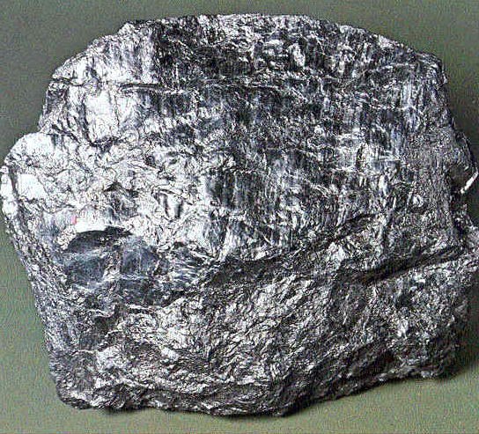
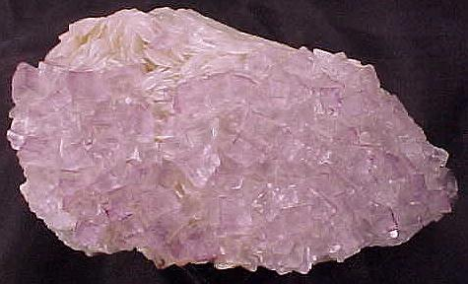
Luster
The way a mineral reflects a light luster.
Either metallic or nonmetallic

Slide 8
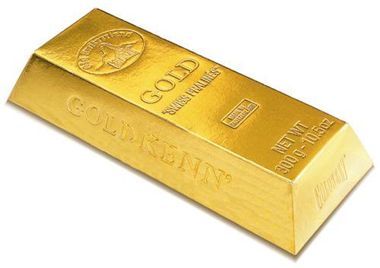
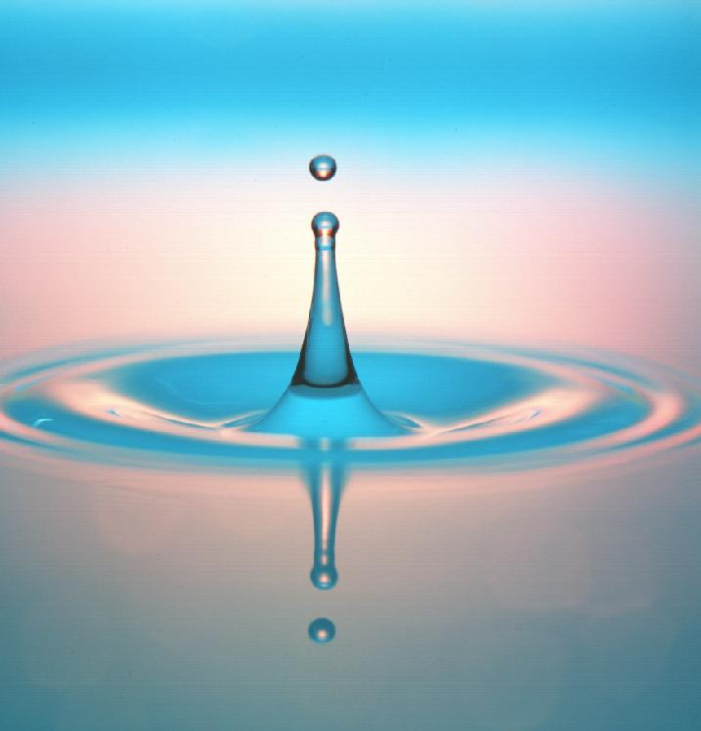
Specific Gravity
The specific gravity of a mineral is the ration of its weight compared with the weight of an equal volume of water.
Gold has specific gravity of 19
It means gold is 19 times heavier than water.
19 times heavier

Slide 9
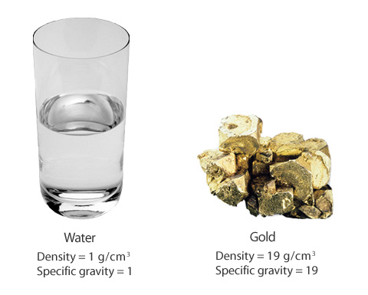
Specific gravity

Slide 10
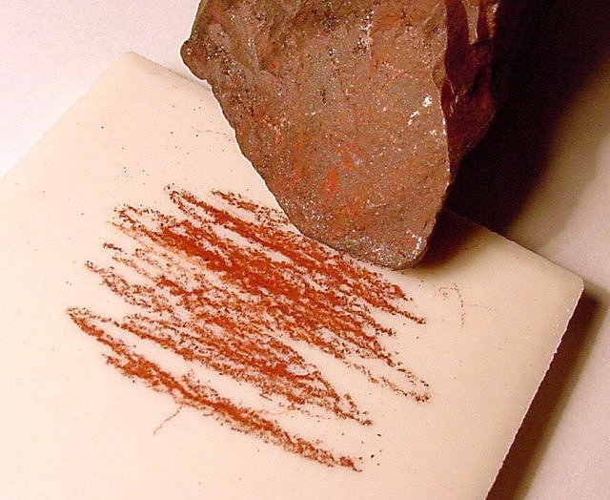
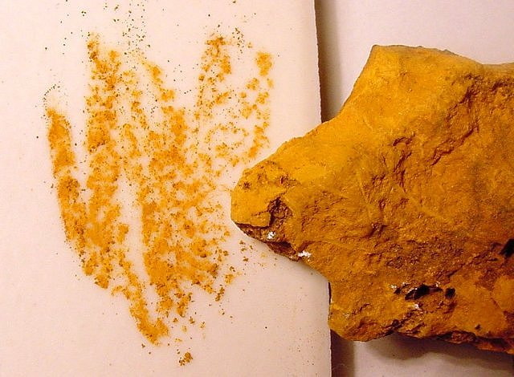
Streak
When a mineral is rubbed across a piece of porcelain tile a streak of powdered mineral is left behind.

Slide 11
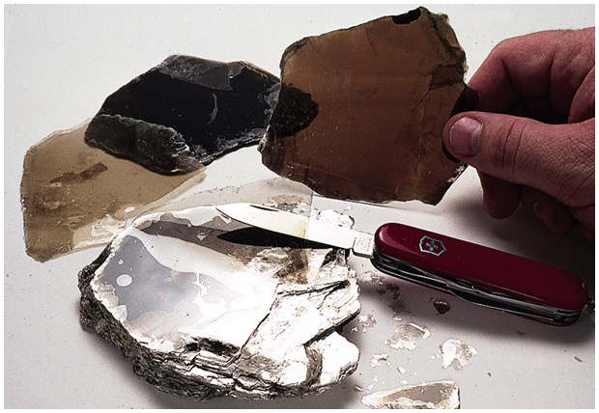
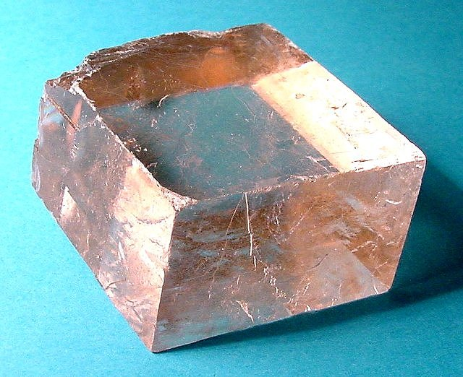
Cleavage
Cleavage is the way that mineral breaks.
Minerals that break along smooth, flat surfaces have cleavage.
Mica has cleavage

Slide 12
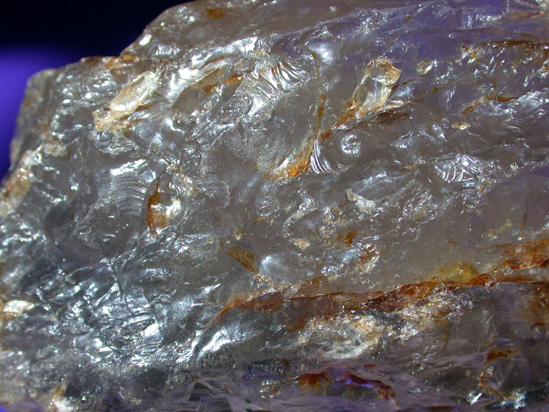
and Fracture!...
Mineral that breaks uneven, rough, or jagged surfaces have fracture.
Quartz has fracture
quartz

Slide 13
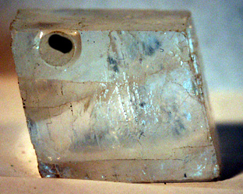
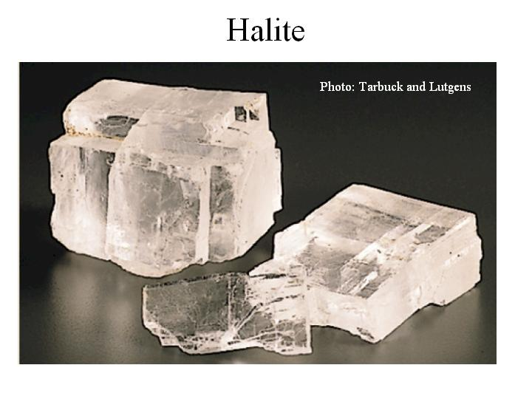
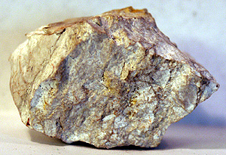
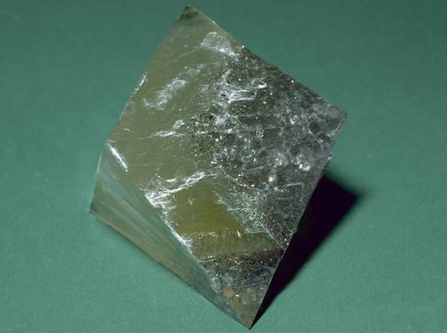
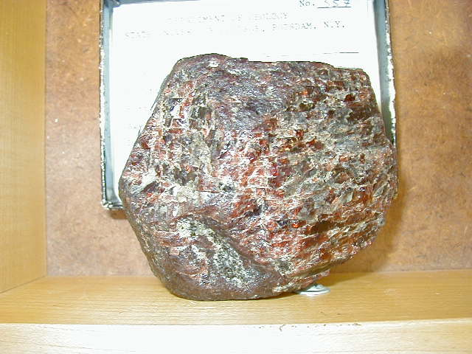
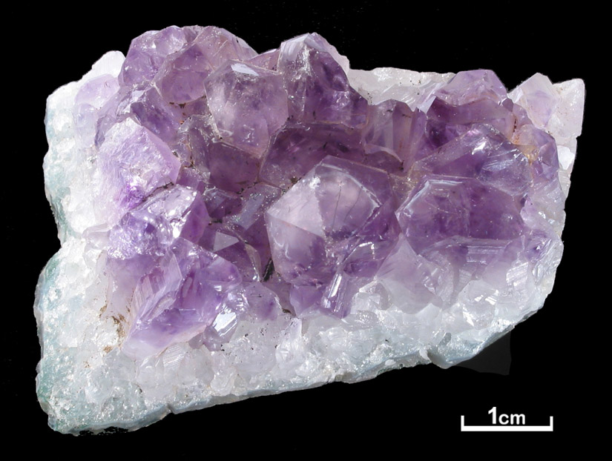
Identify the minerals below for cleavage and fracture
CLEAVAGE
FRACTURE
in

Slide 14

Brain pop movie
Tim and Mobby
Notes:
Baska bilgisayarda tekrardan object properties altndaki movie adresinin guncellenmesi gerekir.

Slide 15
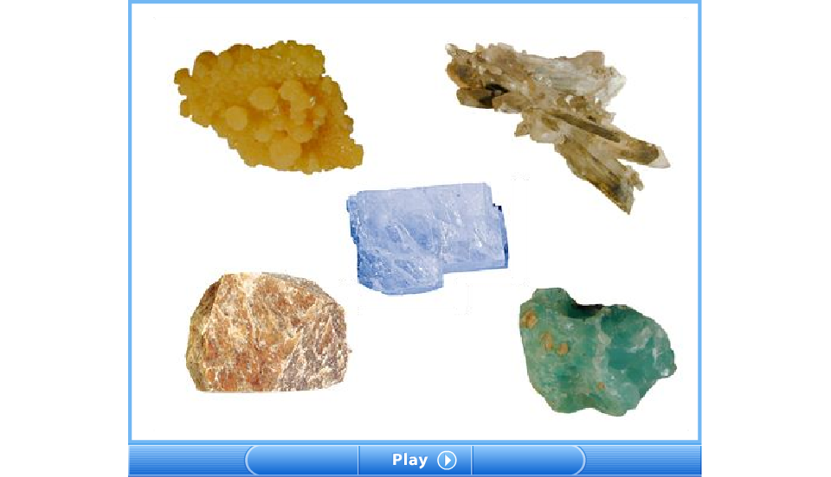
An illustration appearance:luster,color and streak

Slide 16
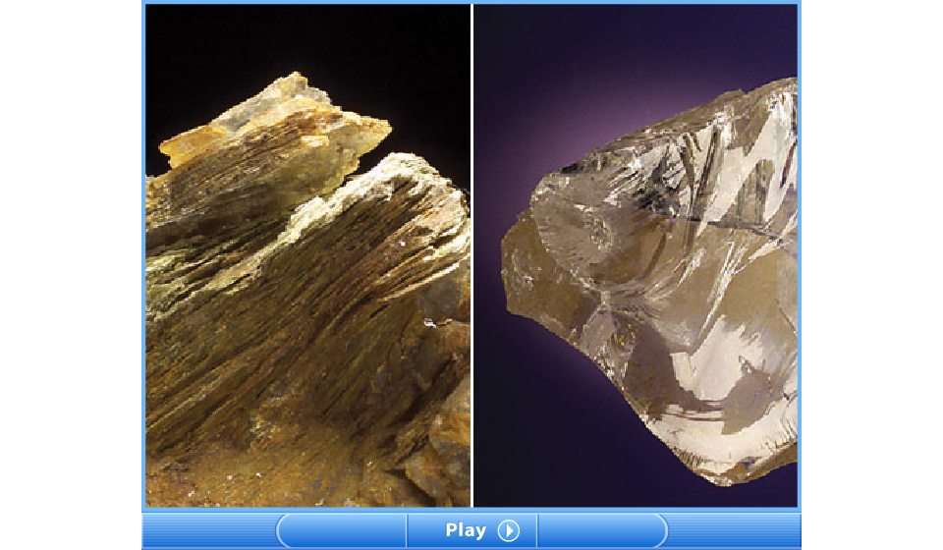
An illustration cleavage and fracture

Slide 17
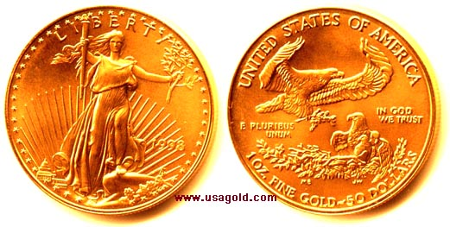
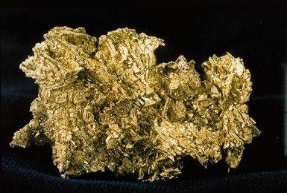
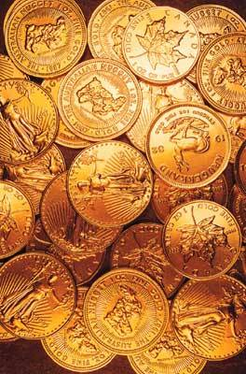
How to find and process gold
Notes:
Baska bilgisayara tasindigi zaman linkerlinin tekrardan duzenlenmesi gerekir

Slide 18
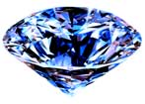
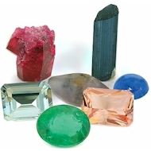
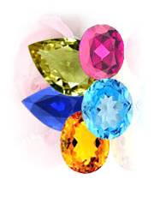
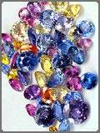
Mineral identification video
Notes:
Baska bilgisayra tasindigi zaman linklerinin tekraradan duzenlenmesi gerekir.

Slide 19
This powerpoint was kindly donated to www.worldofteaching.com
http://www.worldofteaching.com is home to over a thousand powerpoints submitted by teachers. This is a completely free site and requires no registration. Please visit and I hope it will help in your teaching.

